Slide 1
AI Study Buddy
Team Project - MSc Computer Science
Anika Mayesha – D24125187
Lorenzo Palleschi – D24126922
Rumaysa Babulkhair – D24125711
Yurii Sykal – C23512523

Slide 2

Brief Weekly overview
Logo
Retrospectives
Requirement Specification
Login / Registrations Page
Figma Design Overview
Figma Coded Version

Slide 3



Logo Prototype
Feedback received about initial design
Adapted centre to be more fitting for study related service
Bigger companies tend to simplify logos

Slide 4
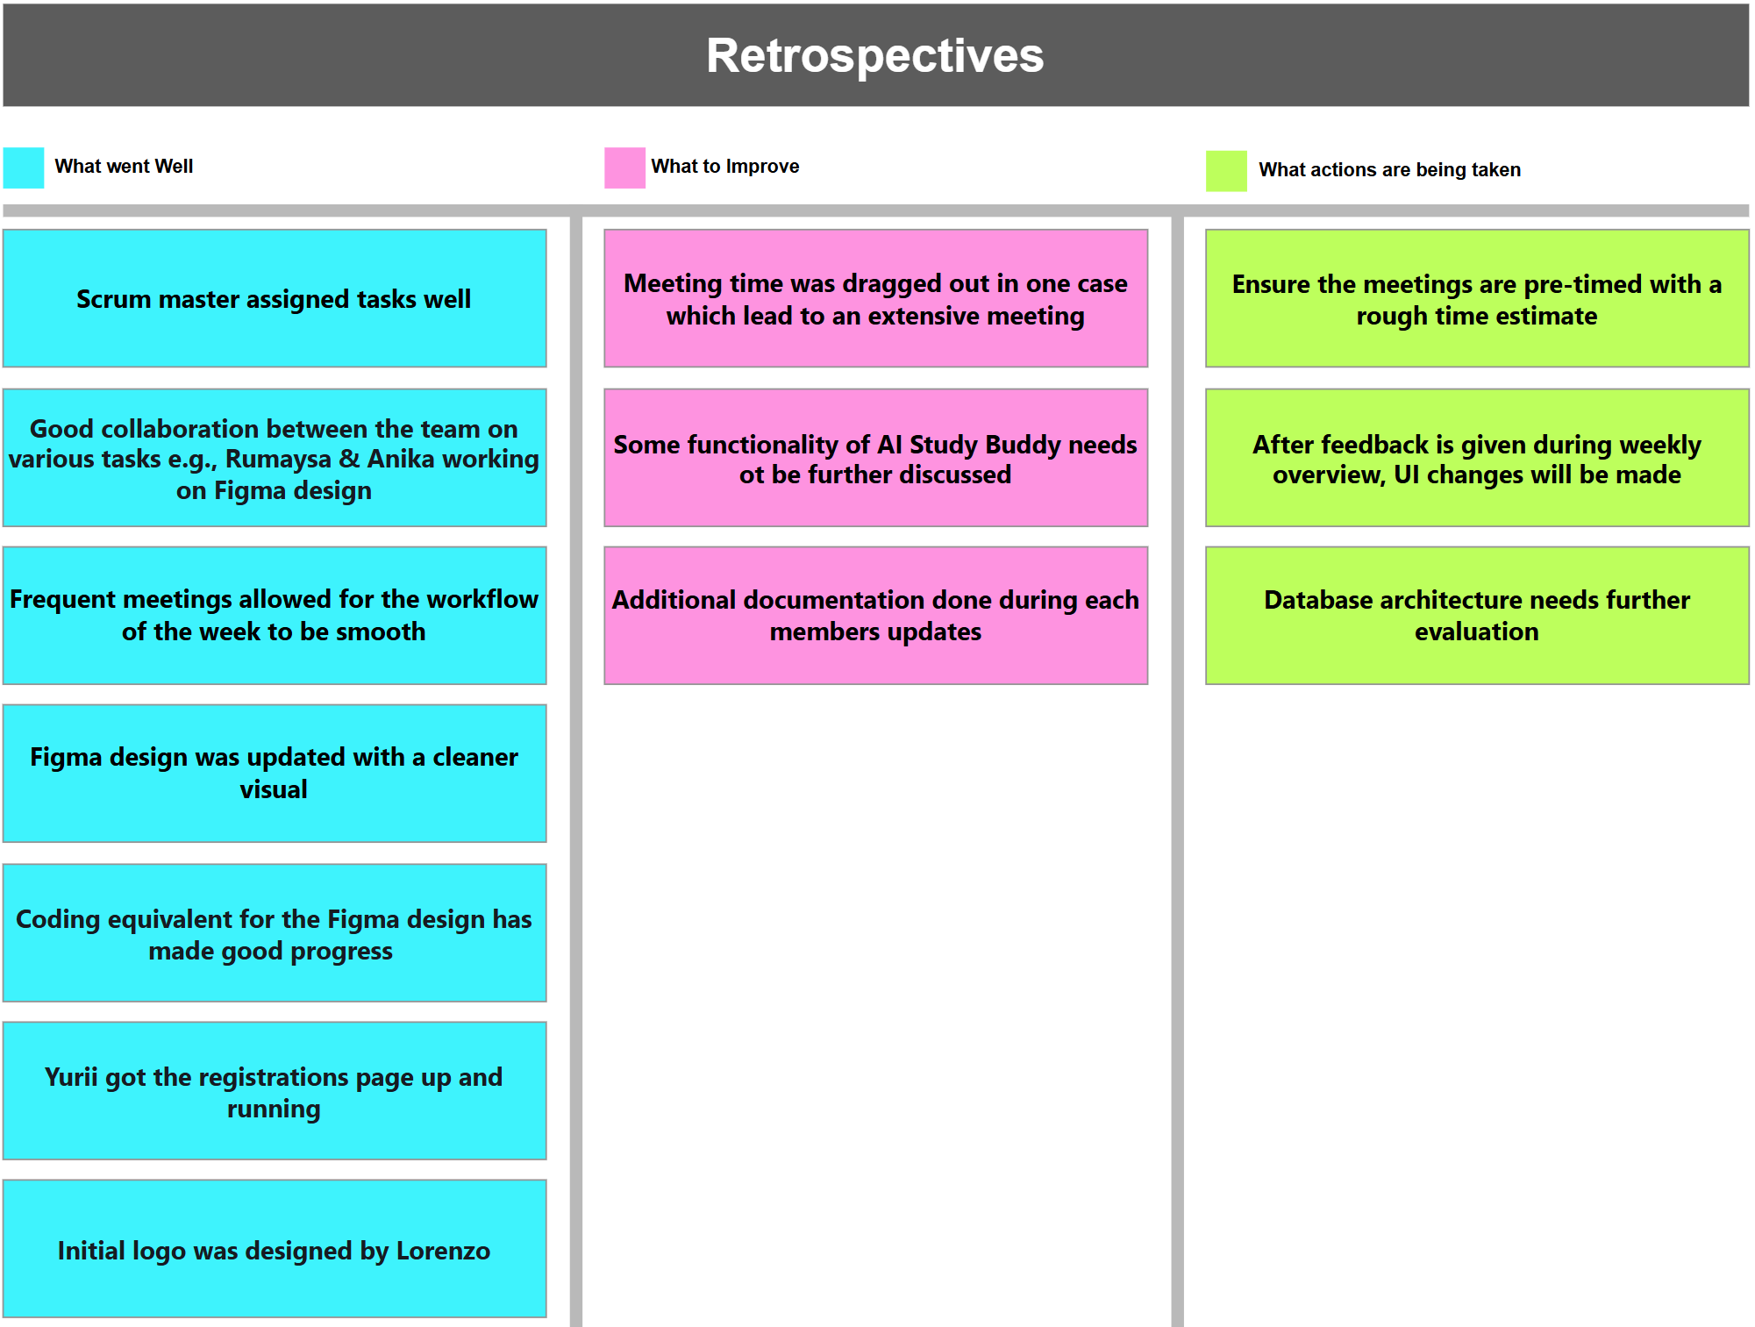

Slide 5
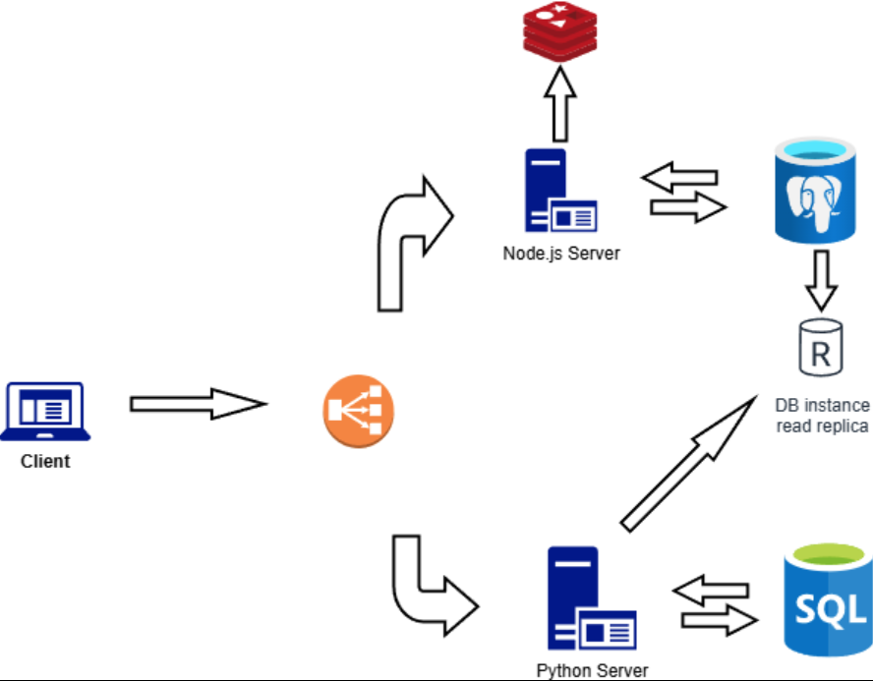
Requirement Specification
Brief details tba

Slide 6
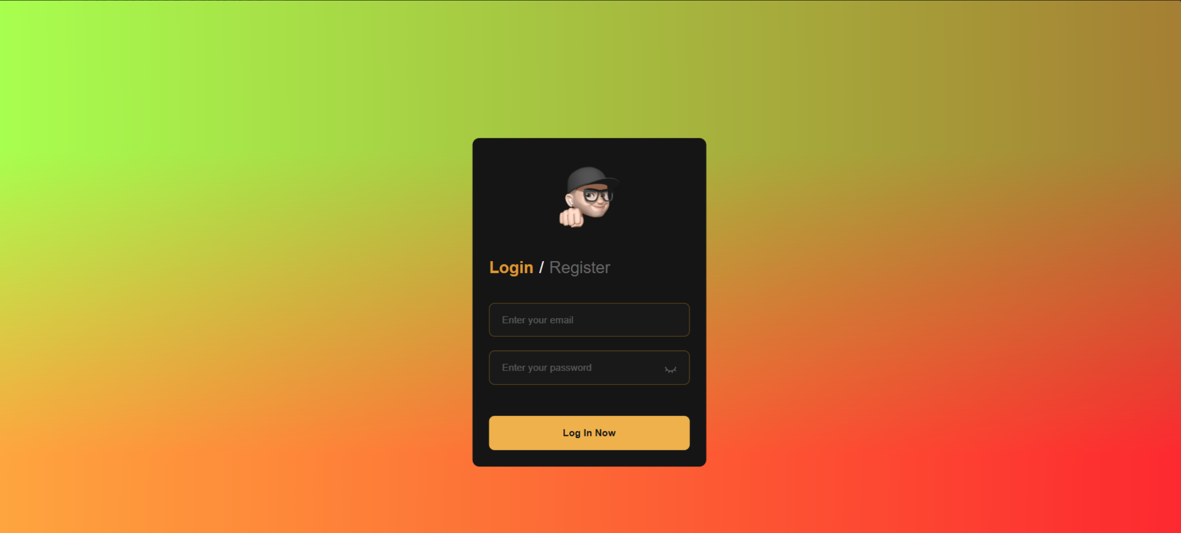
Registrations Page
• Initial version (1.0)
• Functional, but the interface needed to be updated

Slide 7
Updated Registration Page?

Slide 8
Registrations Page Details
Some details of what's used.

Slide 9
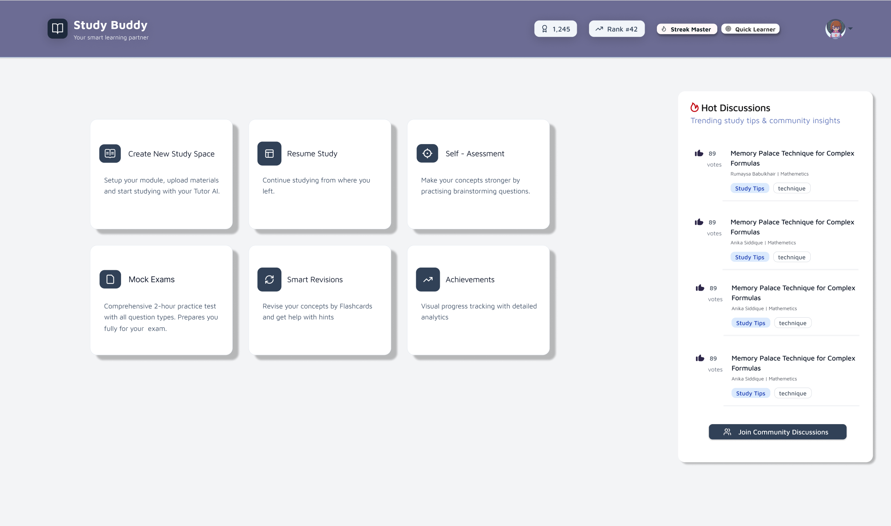
Figma Design (Dashboard)
Figma design is now updated with a sleeker interface
More neutral colour scheme

Slide 10
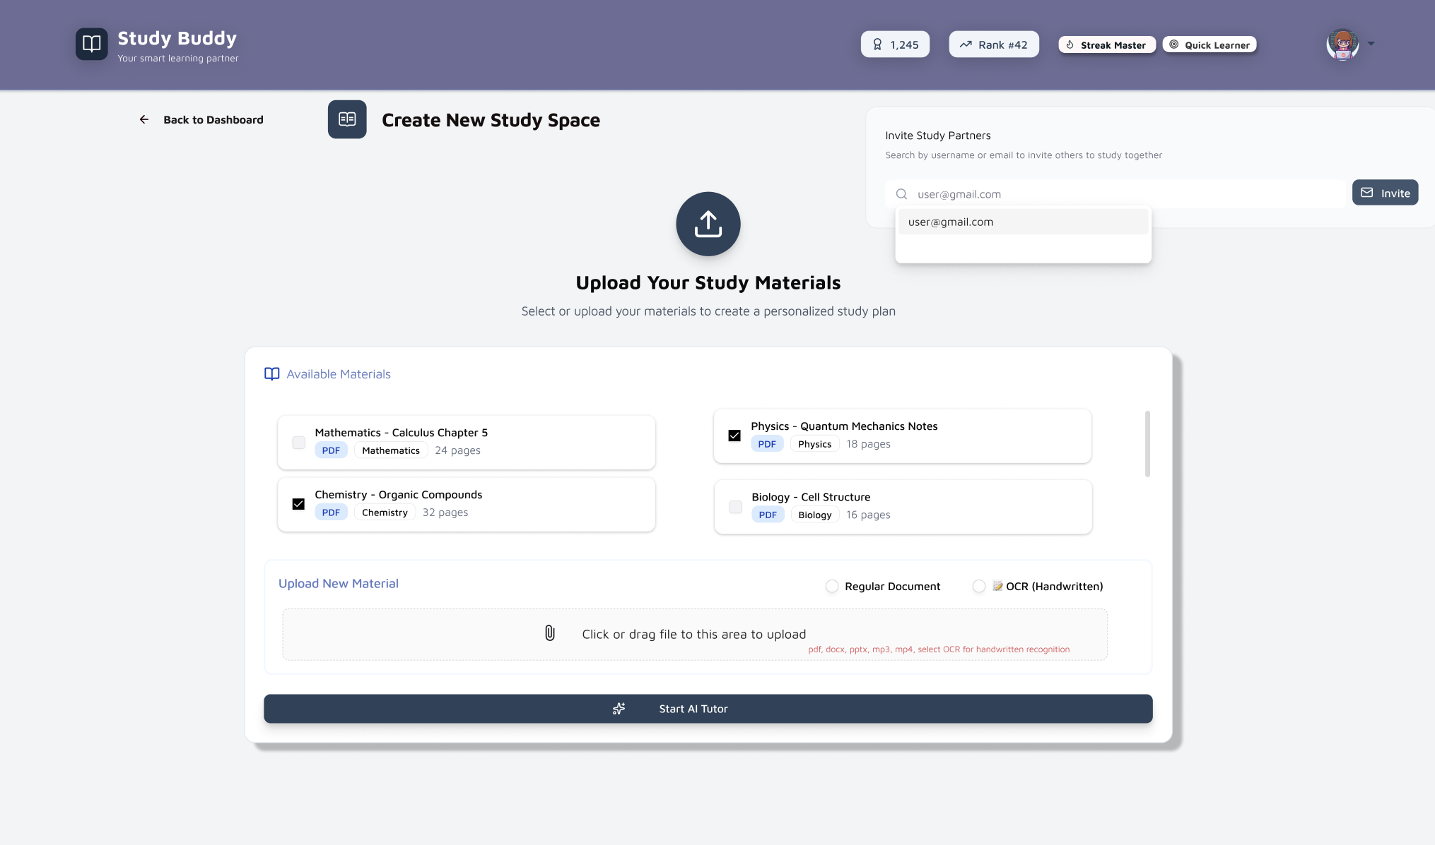
Figma Design (Study Space)
Study materials can be uploaded (various types listed)
Available material can be selected
Study Partners may also be invited

Slide 11
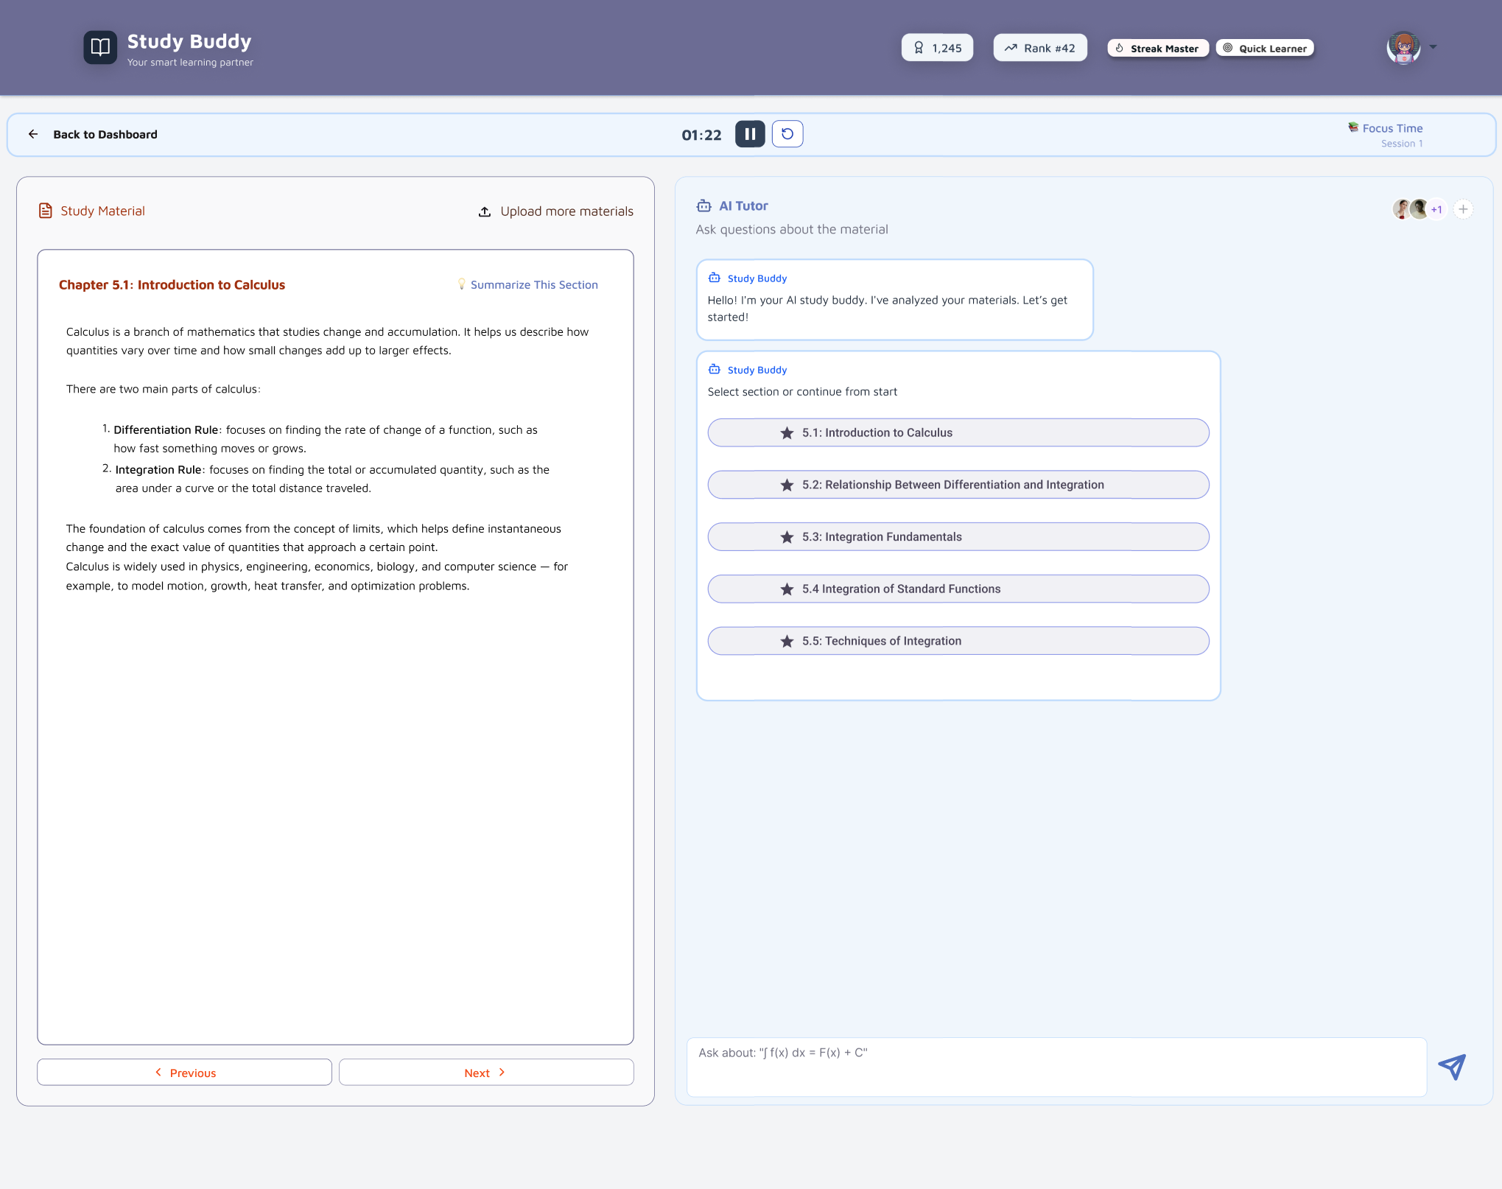
Figma Design (AI Tutor)

Slide 12
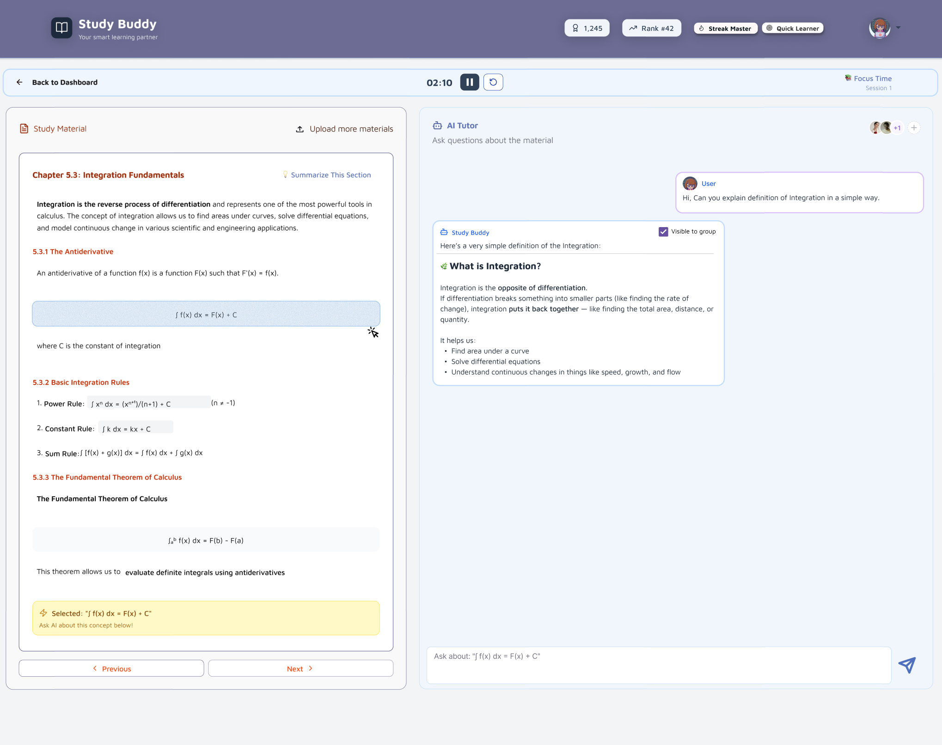
Figma Design (AI Tutor #2)

Slide 13
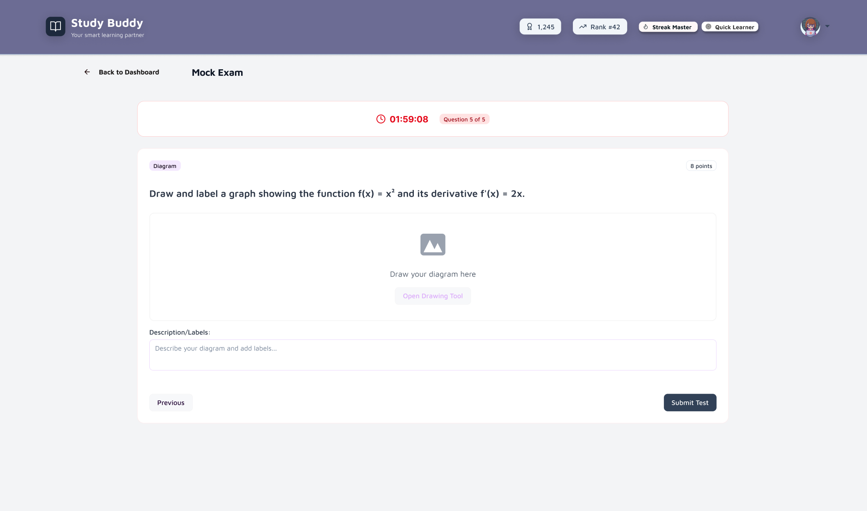
Figma Design (Mock Exam)

Slide 14
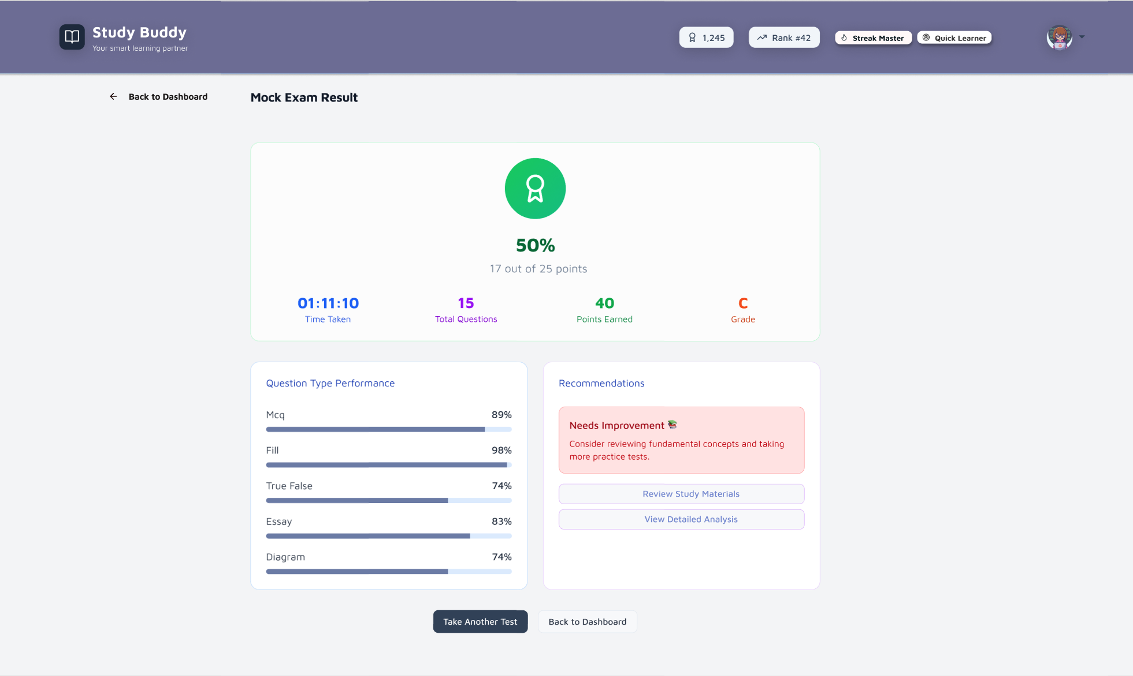
Figma Design (Mock Results)

Slide 15
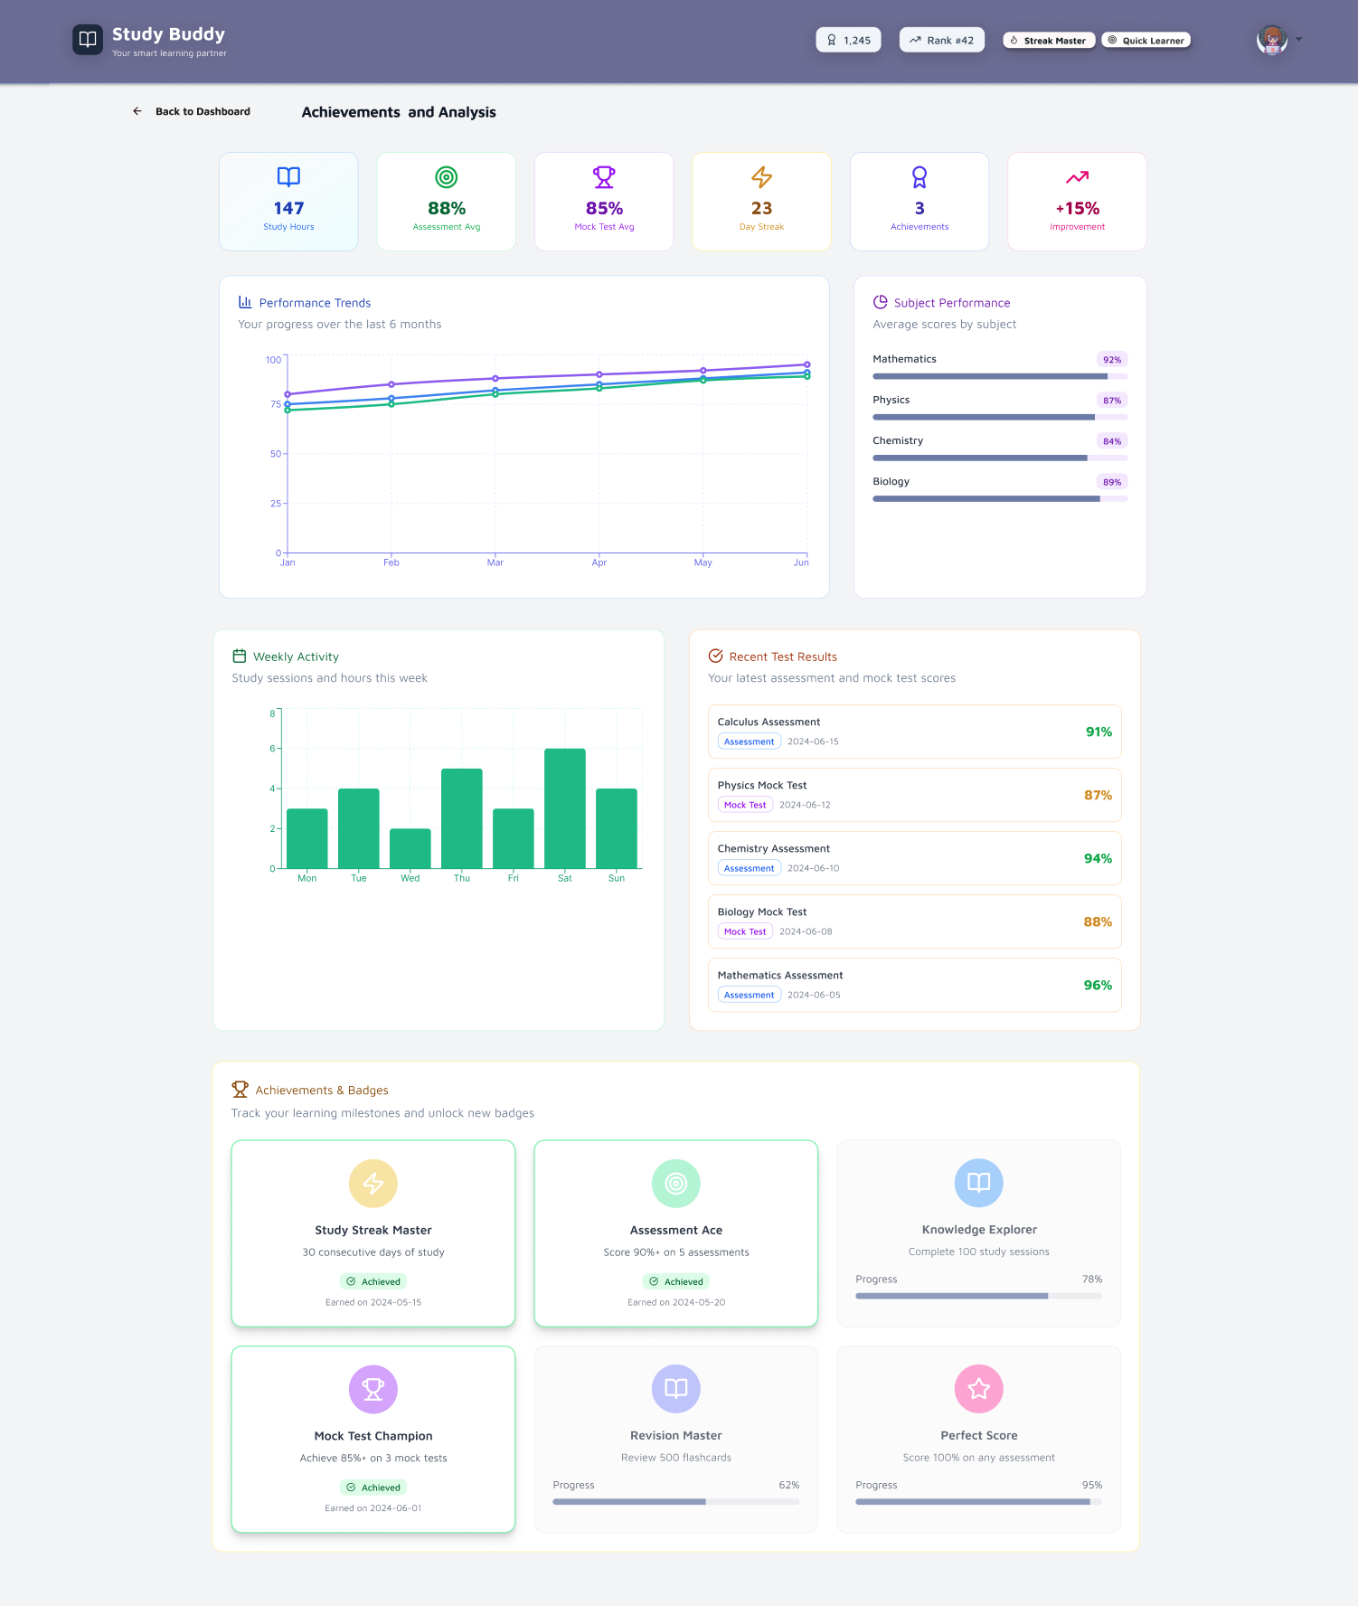
Figma Design (Achievements)

Slide 16
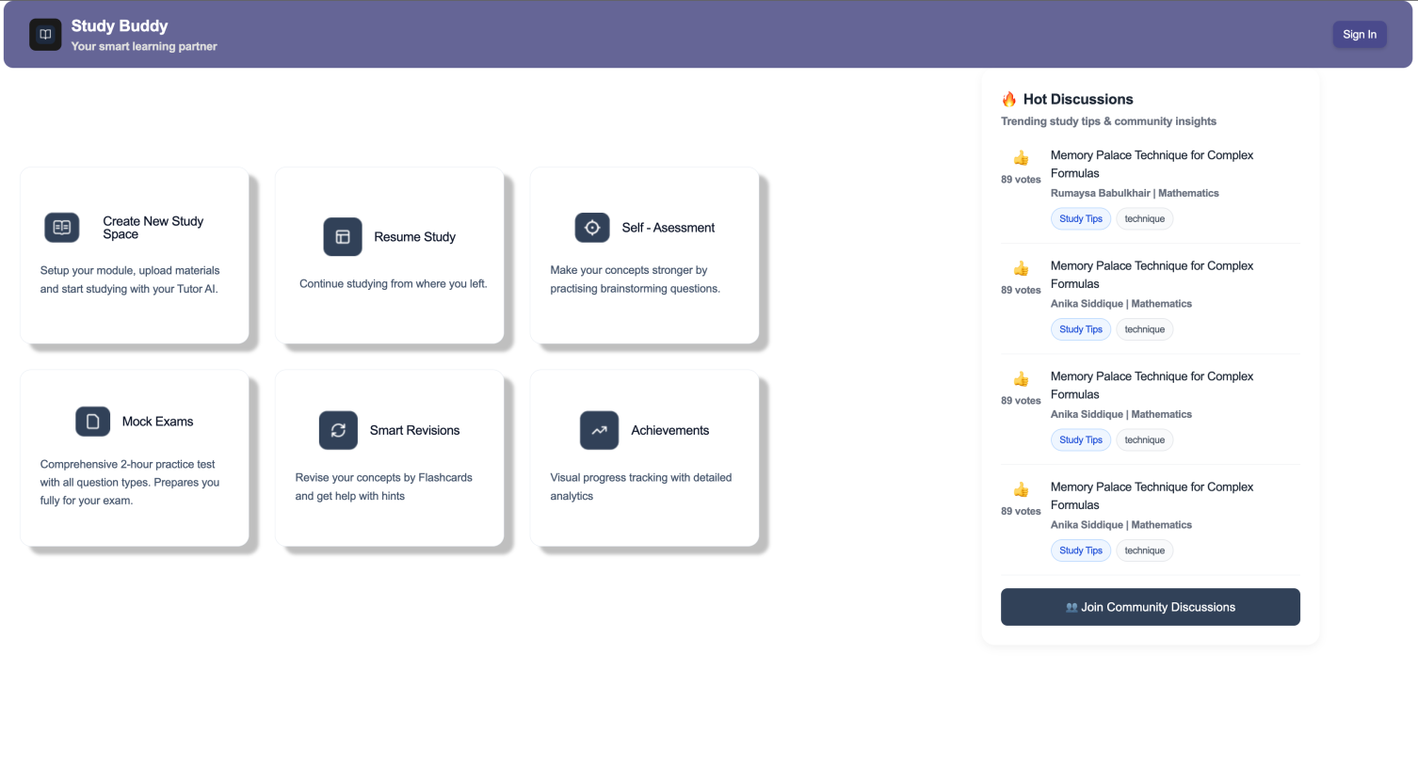
Figma Turned into Live code
Dashboard has been structurally built
Other pages in progress

Slide 17
Thank You
Any Questions?

